Slide 1
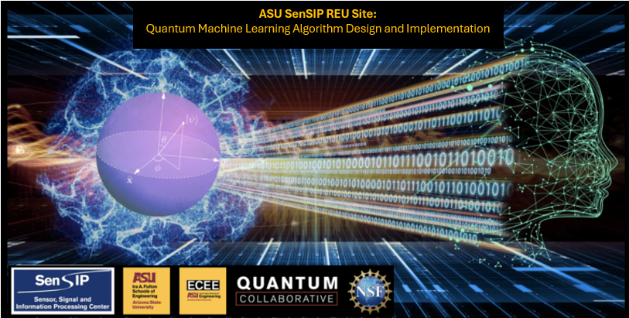

Chris Su
QML REU 2024 – Week 5 Update
Carnegie Mellon University
Mentors: Greg Vetaw, Glen Uehara, Professor Suren Jayasuriya,
Professor Andreas Spanias
NSF Award 2349567

Slide 2
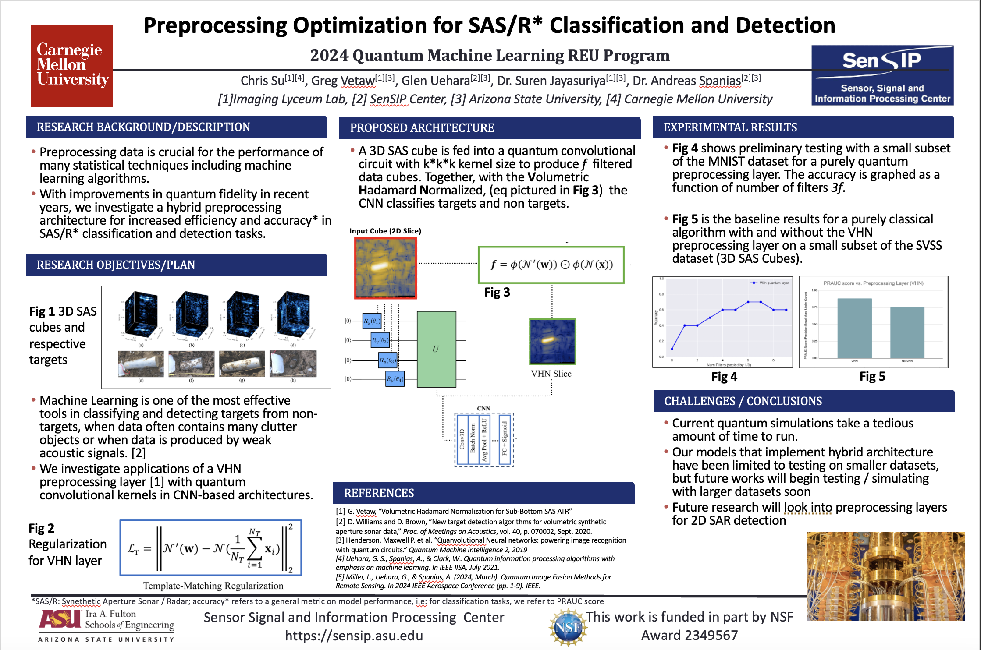
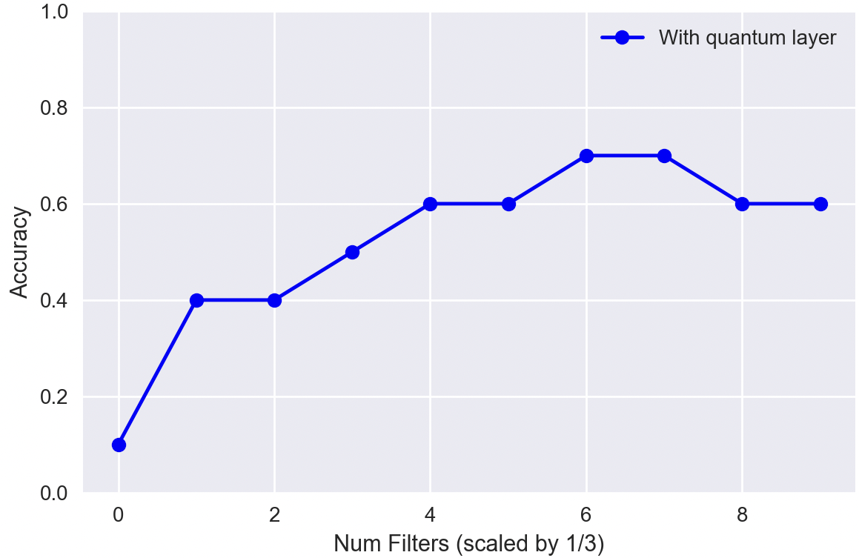
Week 5: Posters, Quantum Preprocessing Implementations
Made posters (pictured right)
Implemented some preliminary quantum preprocessing architectures with MNIST and implemented a paper on quanvolutional neural networks

Slide 3
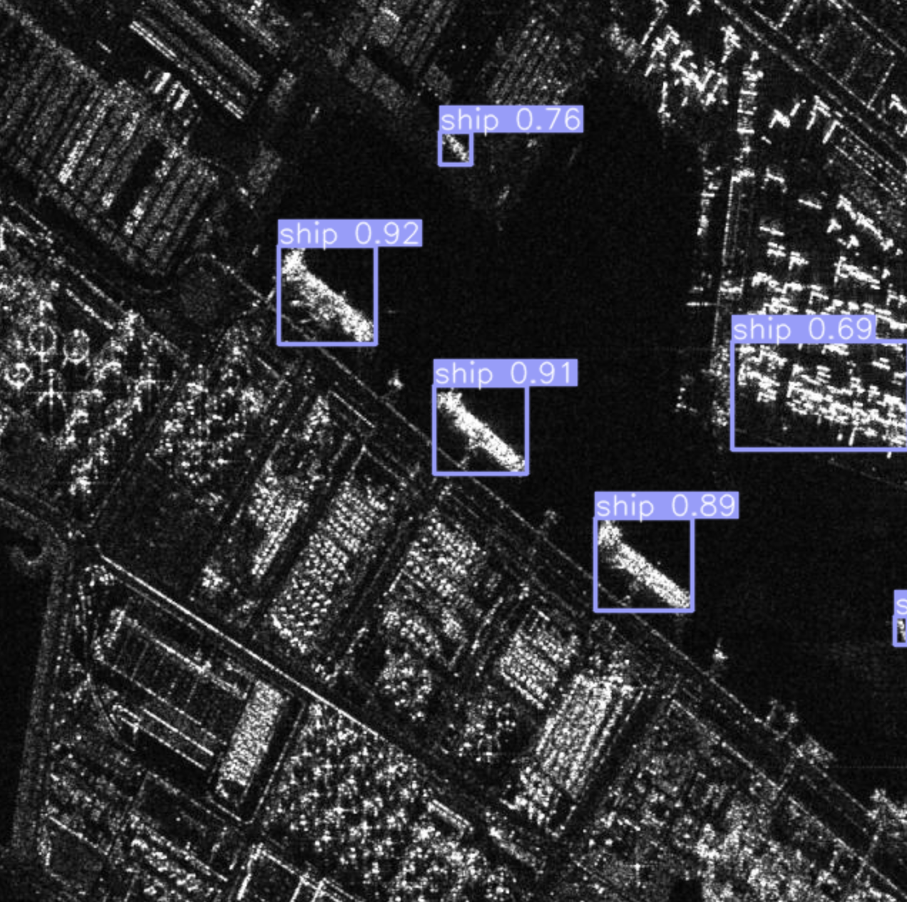
Week 5: YOLO Implementation
Got classical object detection working on SAR data using the YOLO algorithm (You Only Look Once), version 5(?)

Slide 4
Goals for next week?
Add a preprocessing layer to YOLO and see if it improves any metrics
Flesh out hybrid architecture for CNN classification in 3D SAS

